Slide 2
Monochromators
Components
●Monochromator_flat
●Monochromator_curved
●Single_crystal
Use in instrument
●Monochromator
●Analyser
●Sample

Slide 3
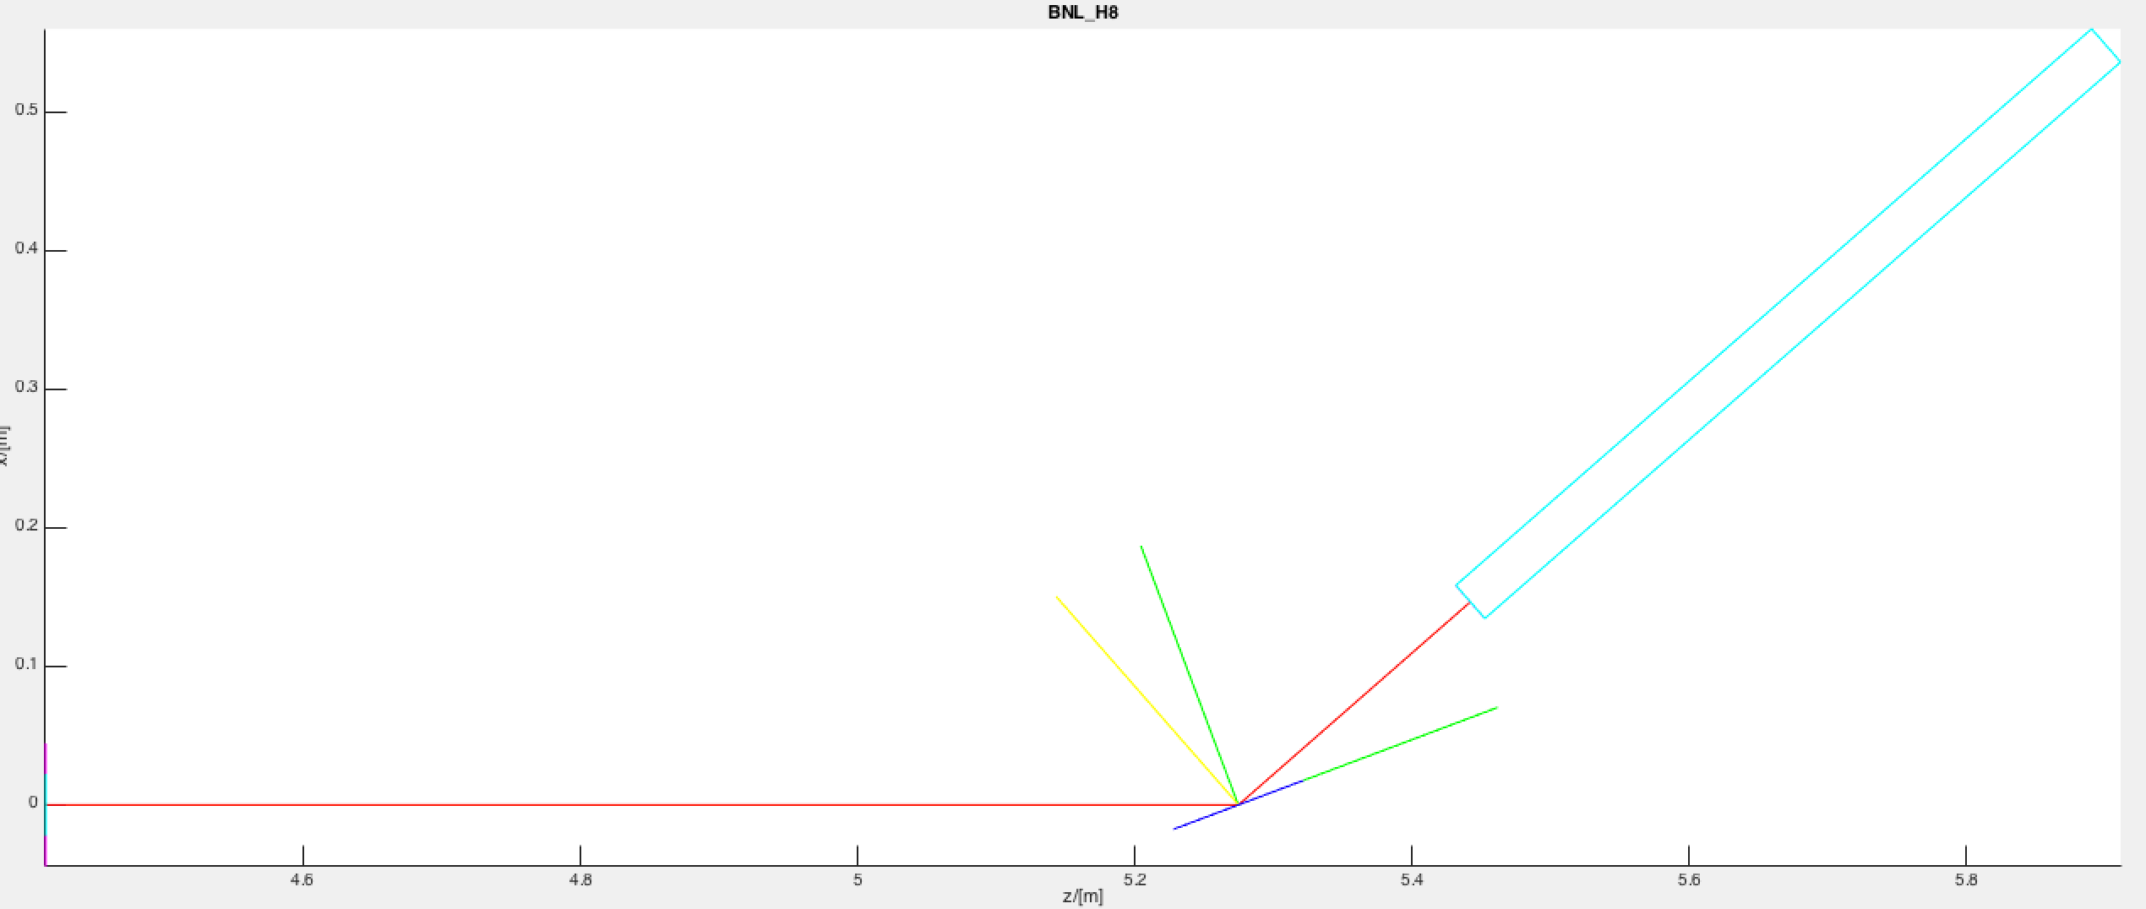
Quick step to the side:
Arm()’s

Slide 4
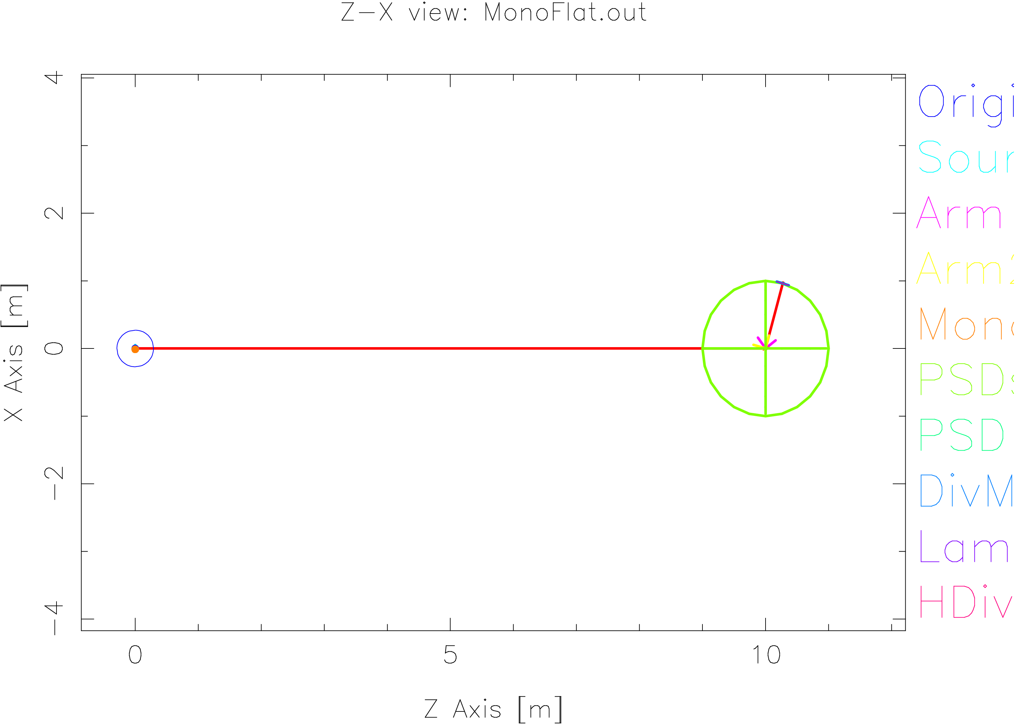
Monochromator_flat
Build an instrument using
Source_simple (0.1m*0.1m, dist=10, lambda0,dlambda, flat wavelength distribution)
●
Two Arm's:one for rotation of mono and one for scattering
●
●
Monochromator_flat (0.1m*0.1m @ z=10m, from source
mosaic=40,r0=0.8, (EXTEND if not scattered then absorb)
PSD_monitor, Divergence_monitor, L_monitor
●

Slide 5
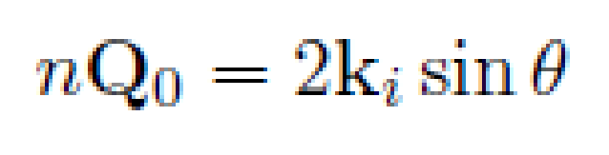
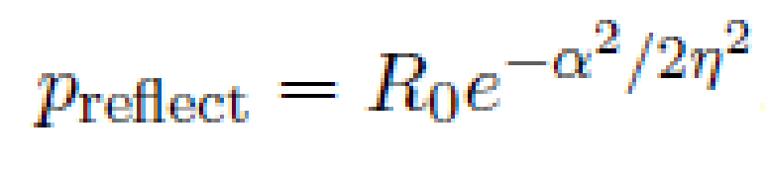
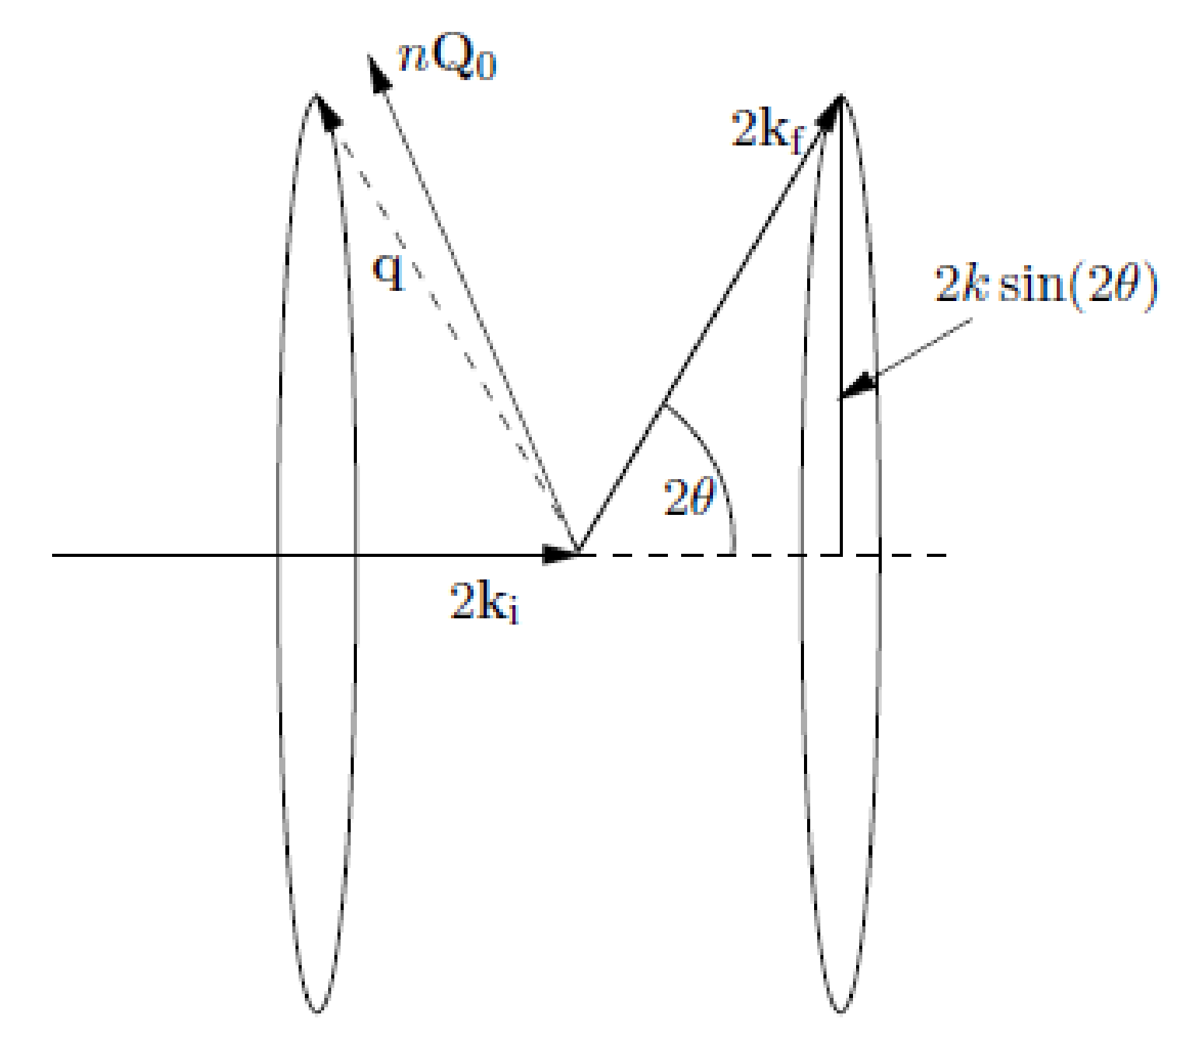

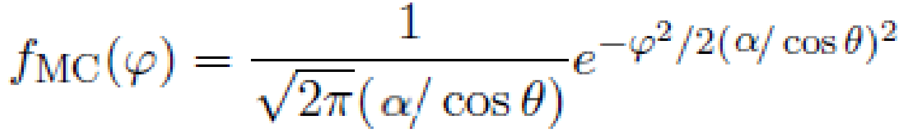
Monochromator_flat
Ven 2010
essworkshop.org
Properties:
Infinitely thin, one scattering vector perpendicular to surface
●
- no multiple scattering/secondary extinction
- total reflectivity r0, not scattering cross sections
Mosaic, vertical and horizontal η
●
●
No variance of lattice parameter Δd/d=0
Algorithm:
●
If intersect determine order n,
●From mosaicity η and angle α from Q0 find prob
●
If reflected, determine direction on D-S cone
●
Calculate weight for

Slide 6
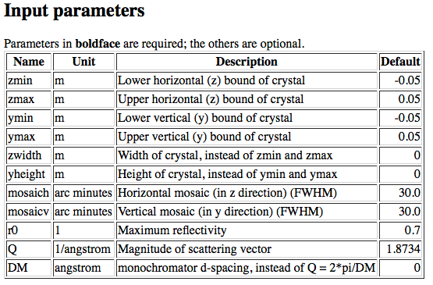
Monochromator_flat (link)
● xwidth = 0.1, yheight = 0.1,
● mosaich = MOSH, mosaicv = MOSV,
● r0 = 0.8, Q = 1.8734 (PG 002)

Slide 7
Monochromator_flat
Basic setup of the instrument file
●Set source wavelength 4.0-4.1Å (LMIN=4.0, LMAX=4.1)
●Put mosaicity to 40 min (MOSH=40, MOSV=40)
●Set the monitors at the Bragg angle for the monochromator scattering for λ=4.045Å (rotate a2)
●Set monochromator rotation angle in scattering condition (a1=a2/2)
●Observe the wavelength distribution (n=1e6 rays is enough…)
Play!
●Try to put a broader wavelength interval from the source (2.0-4.1Å)
●Observe wavelength distribution
●Change to (vertical) mosaicity and observe the PSD
●Change the (horizontal) mosaicity and observe the energy monitor
●If you put a PSD_monitor_4PI (radius=1-nm) at the sample
position you can confirm that only one scattering vector is present

Slide 8
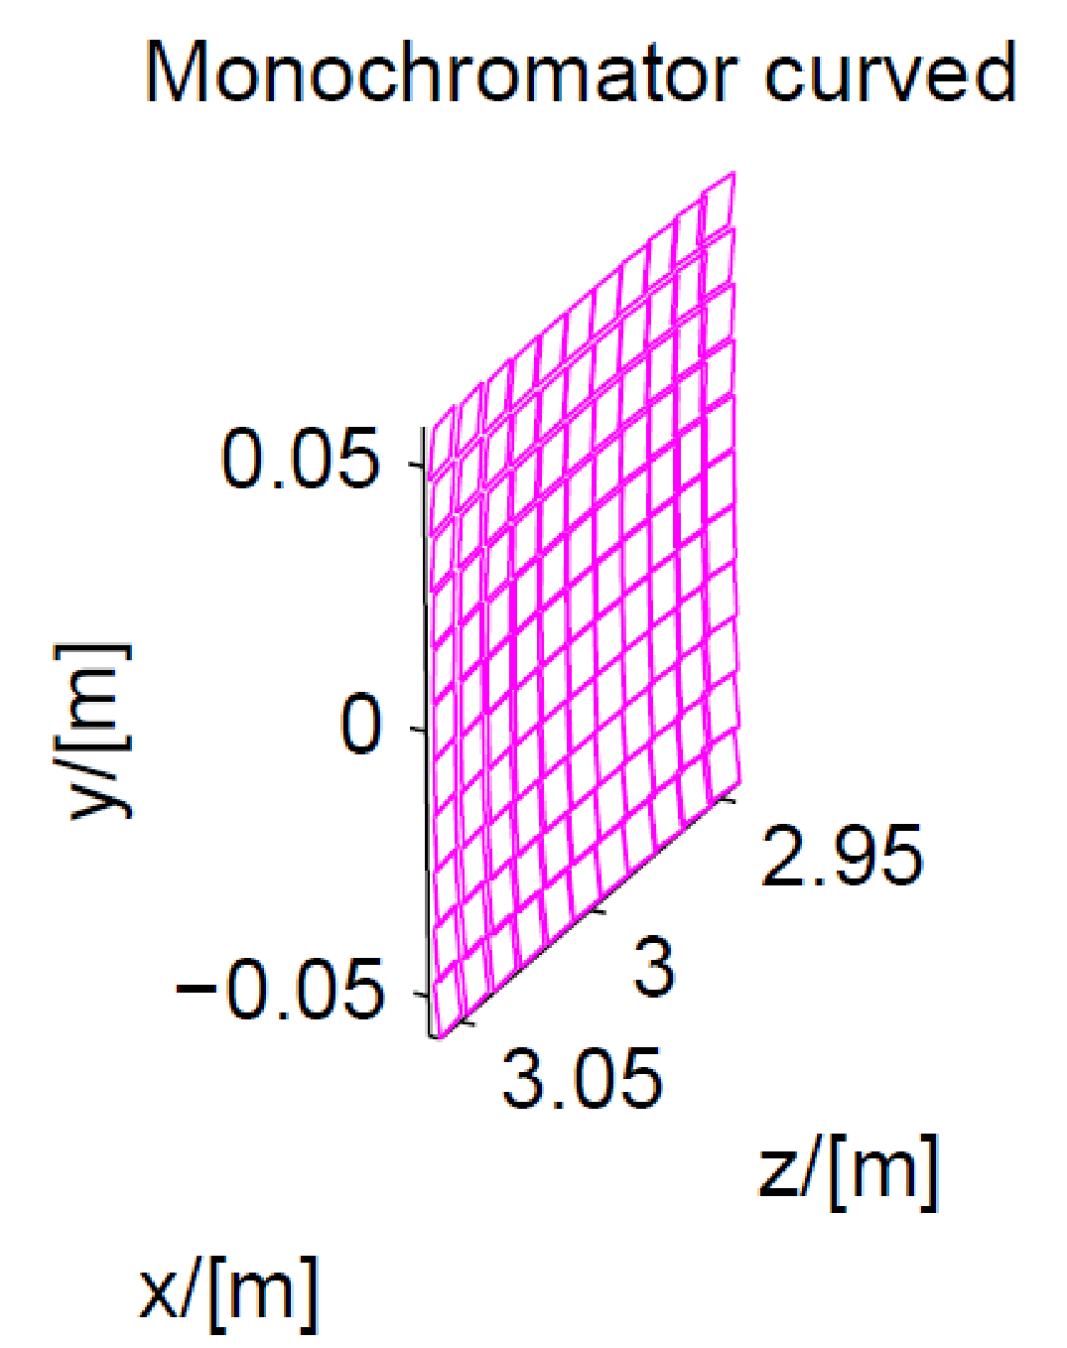
Monochromator_curved
Properties
●Array of single mosaic crystals (blades) with one scattering vector
●Infinitely thin, one scattering vector perp. to each surface of blade - no multiple scattering/secondary extinction
- total reflectivity r(k), not scattering cross sections
- total transmission t(k)
●Mosaic, vertical and horizontal η
●No variance of lattice parameter Δd/d=0
Algorithm
For each individual blade the same as Monochromator_flat

Slide 9
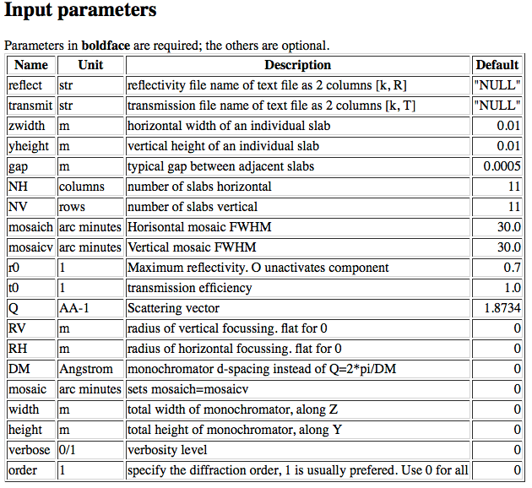
Monochromator_curved (link)
●5 vertical slabs :NV=5, yheight=0.02, zwidth=0.1, RV=1
●Use reflecivity list 'HOPG.rfl' provided in McStas datafiles
●Use transmission list 'HOPG.trm' provided in McStas datafiles
● r0 = 1,Q = 1.8734 (PG 002)

Slide 10
Monochromator_curved
Basic setup of the instrument
●Set source wavelength 4.0-4.1Å (LMIN=4.0, LMAX=4.1)
●Put mosaicity to 40 min (MOSH=40, MOSV=40)
●Set monochromator rotation angle a1 in scattering condition
●Set the monitors a2 at the Bragg angle for the monochromator
scattering
●Observe the wavelength distribution (n=1e6 is enough...)
Play!
●Observe the influence of the focusing monochromator on the PSD (you can put it flat by setting RV=0)
●Observe the influence of the focusing monochromator on the divergence
●You can change the incoming wavelength (2.0-2.1 Å, second order scattering) and observe the intensity is smaller due to smaller reflectivity in comparison to constant r0

Slide 11
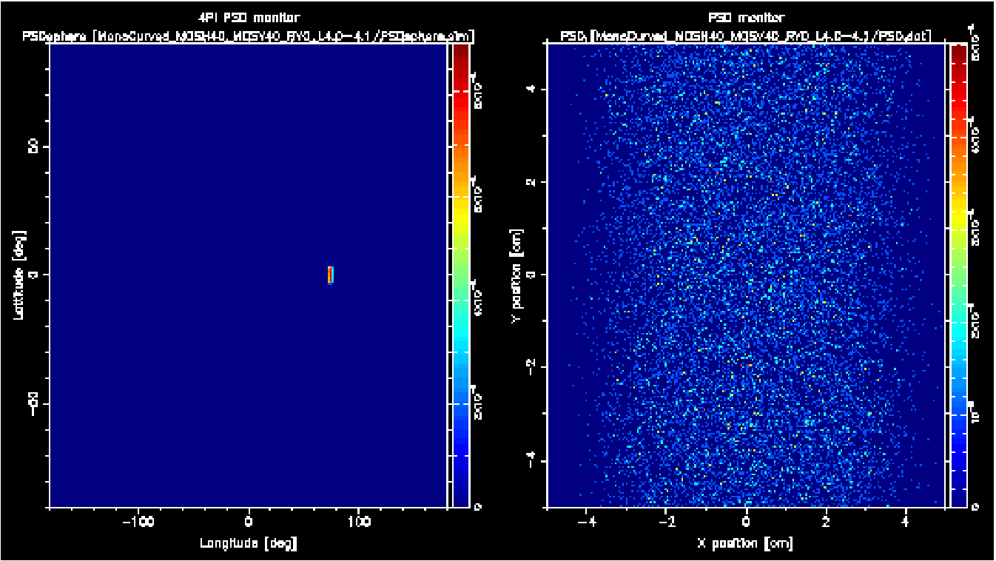
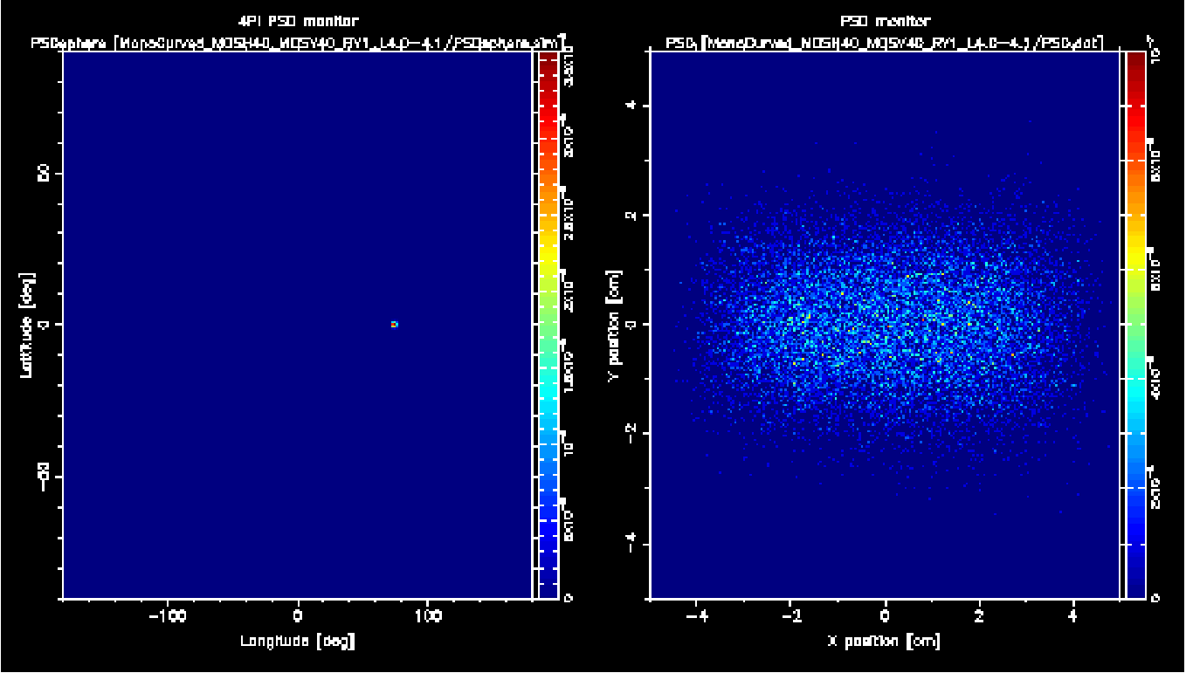
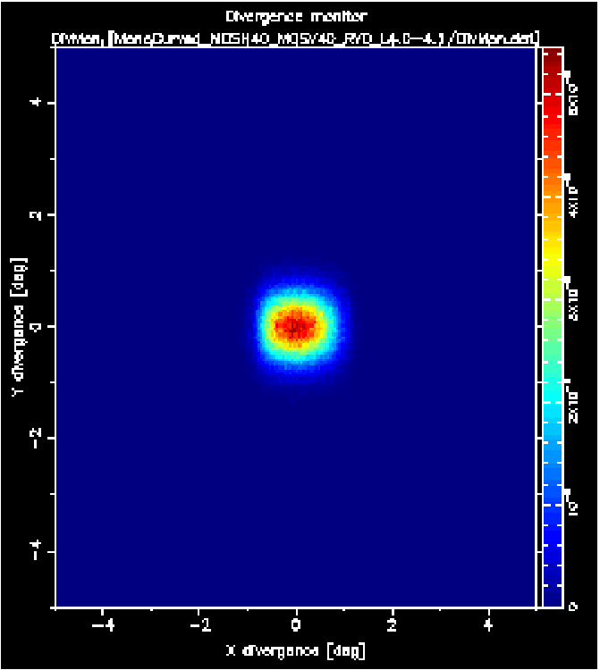
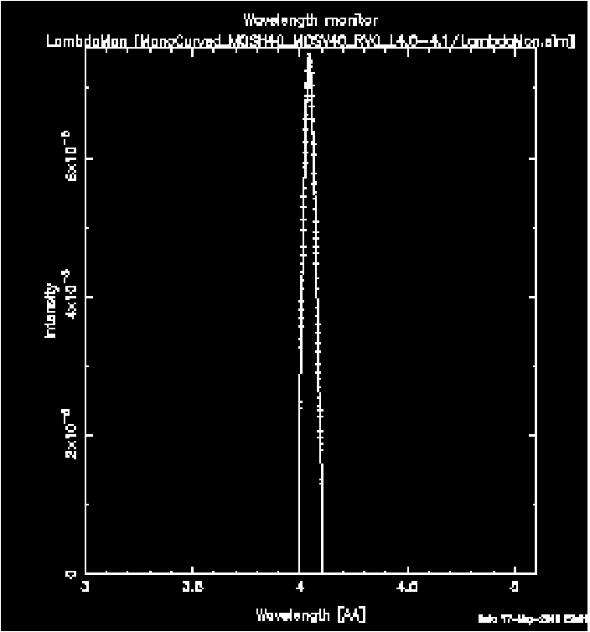
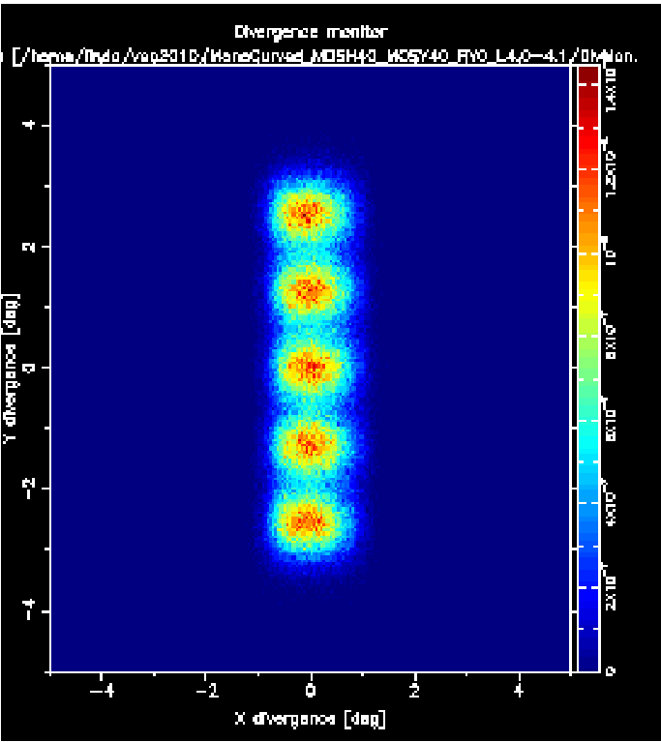
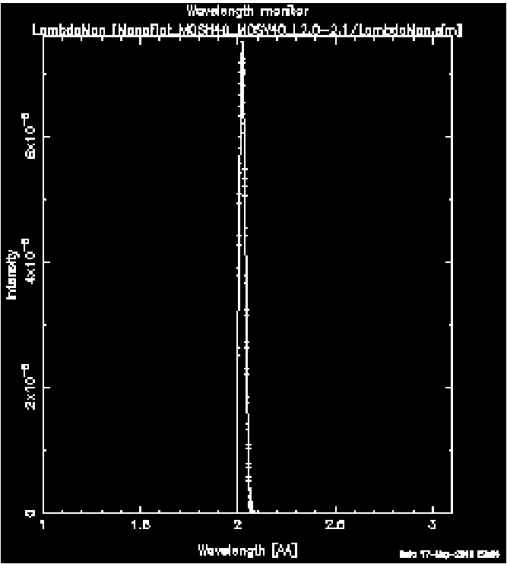
Monochromator_curved
No focus
With focus

Slide 12
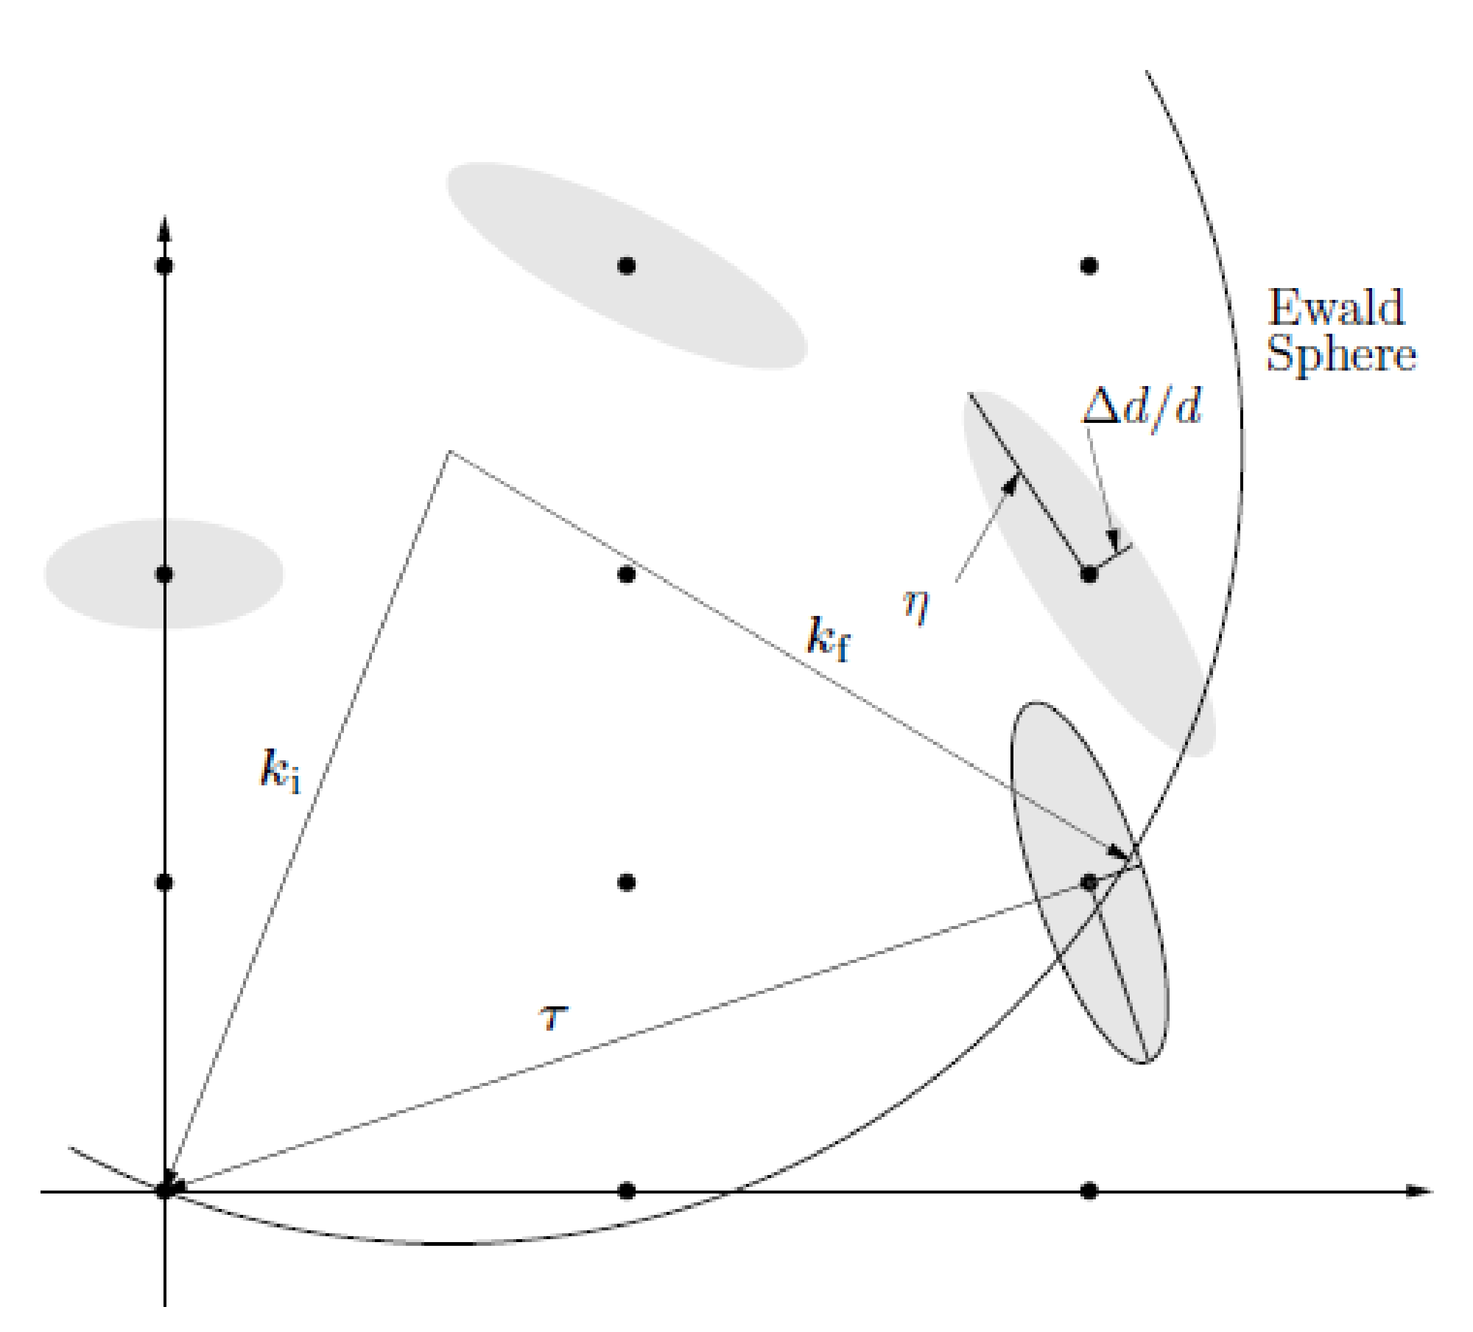
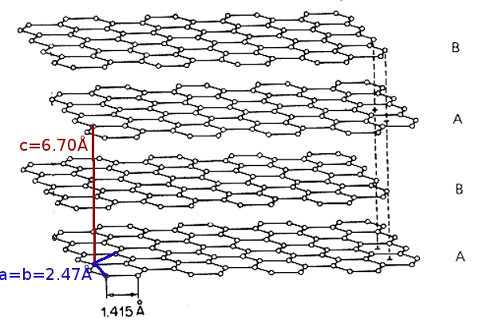
Single_crystal
Properties
●Thick, flat single crystal
- multiple scattering
- absorption
●- incoherent scattering
●Mosaic, isotropic (anisotropic around sample lattice axes)
●Variance of lattice parameter Δd/d=0

Slide 13
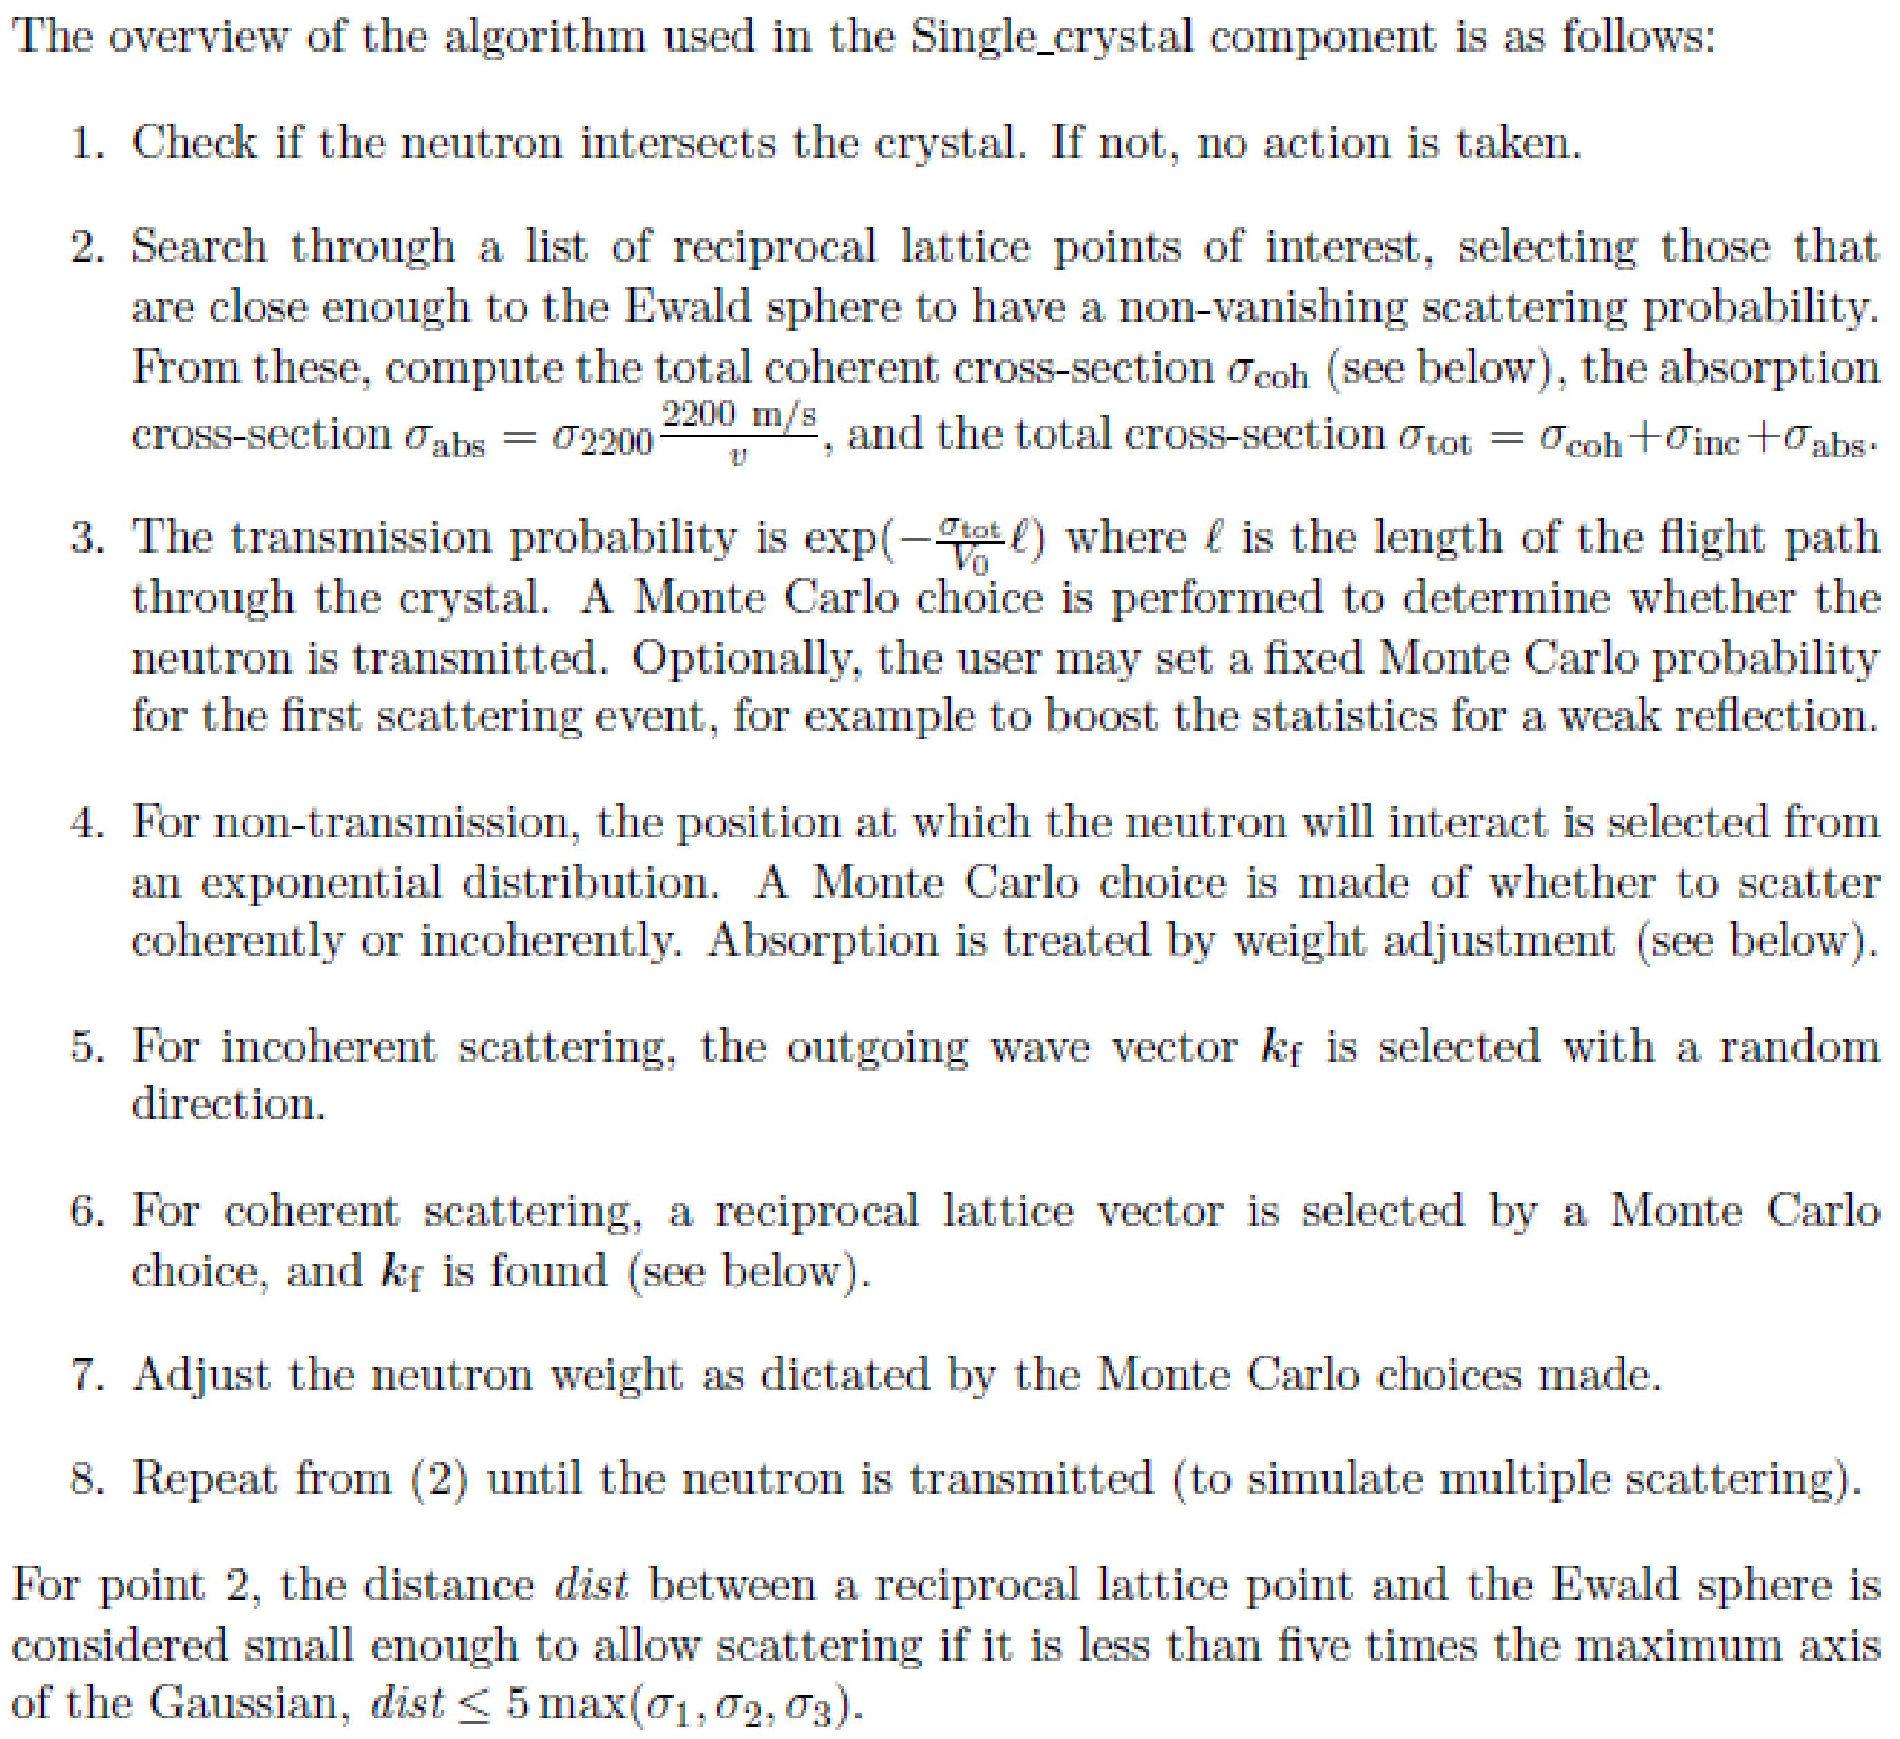
Single_crystal - algorithm

Slide 14
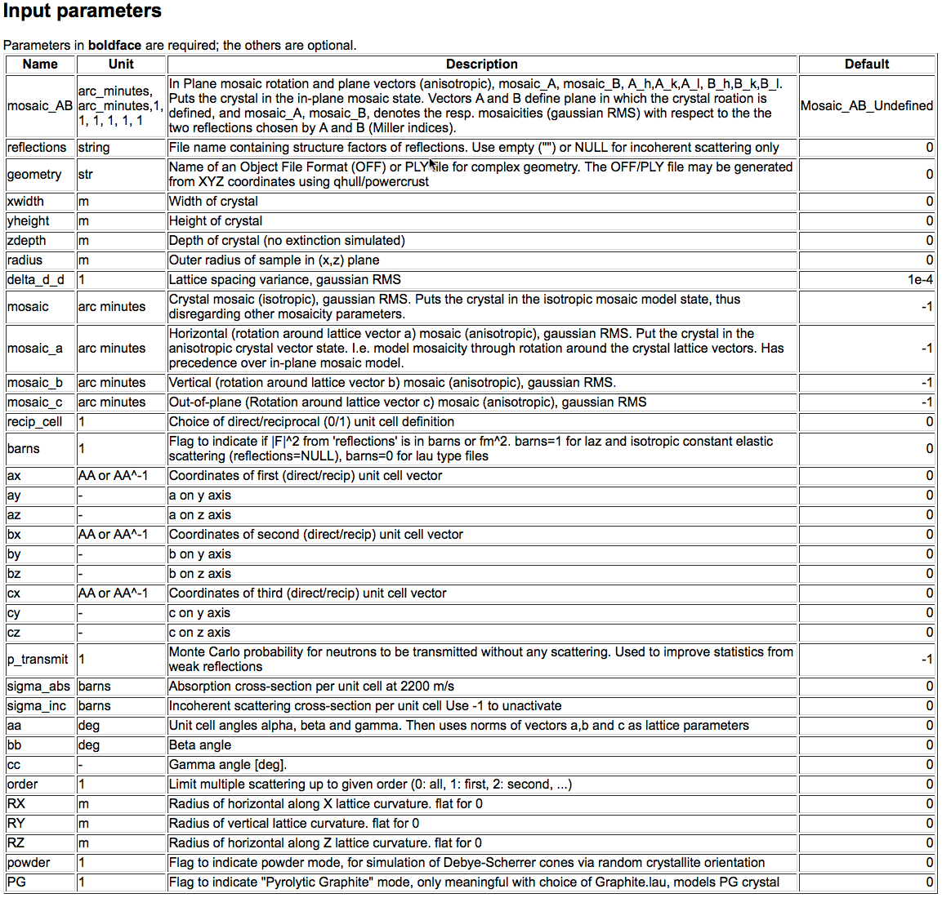
Single_crystal (link)

Slide 15

Single_crystal - Basic setup
●A 2mm slab 0.1m*0.1m, small variance of lattice par, var. mos.:
xwidth = 0.002, yheight = 0.1, zthick = 0.1, delta_d_d = 1e-4, mosaic = MOS
●Put the crystal with c axis along x, and b axis along z:
ax = 0, ay = 2.14, az = -1.24, ( α = 120 deg)
bx = 0, by = 0, bz = 2.47,
cx = 6.71, cy = 0, cz = 0,
●Set the right reflection list (h k l F² [barns]) for graphite reflections = "C_graphite.lau",
● σabs, σinc [barns] for graphite
sigma_abs = 0.014, sigma_inc = 0.004,
●Multiple scattering order = 0 (all)
●Set monochromator rotation angle a1 in
scattering condition
●Set the monitors a2 at the Bragg angle
for the monochromator scattering
X
z

Slide 16
Single_crystal
Play!
●Set a broader wavelength band from the source (2.1-4.1 Å)
●Observe the many reflections on the 4π PSD! ( use log-scale) -this is why we need monochromator shielding :)
●You can also increase the incoherent scattering or absorption cross-section to observe the effect
●Or with the mosaicity or variance of lattices-pacing

Slide 17
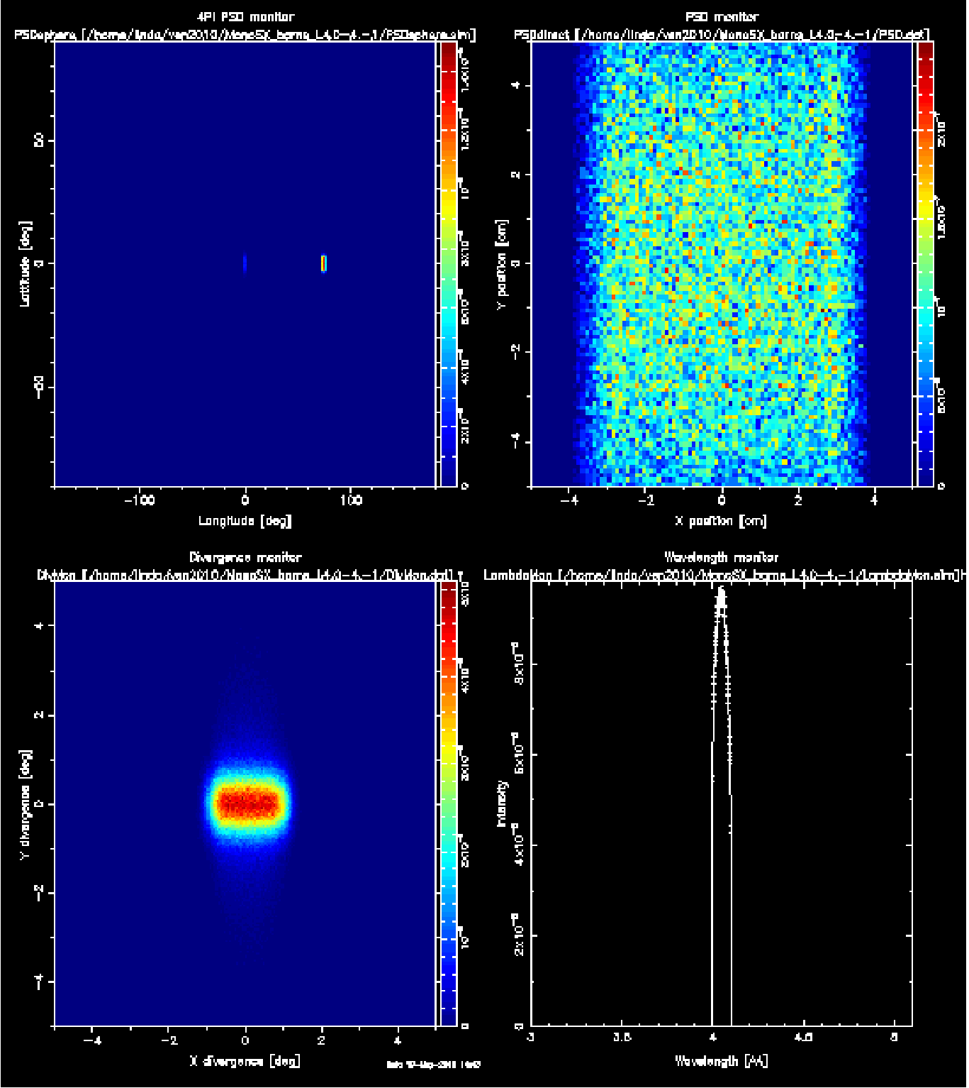
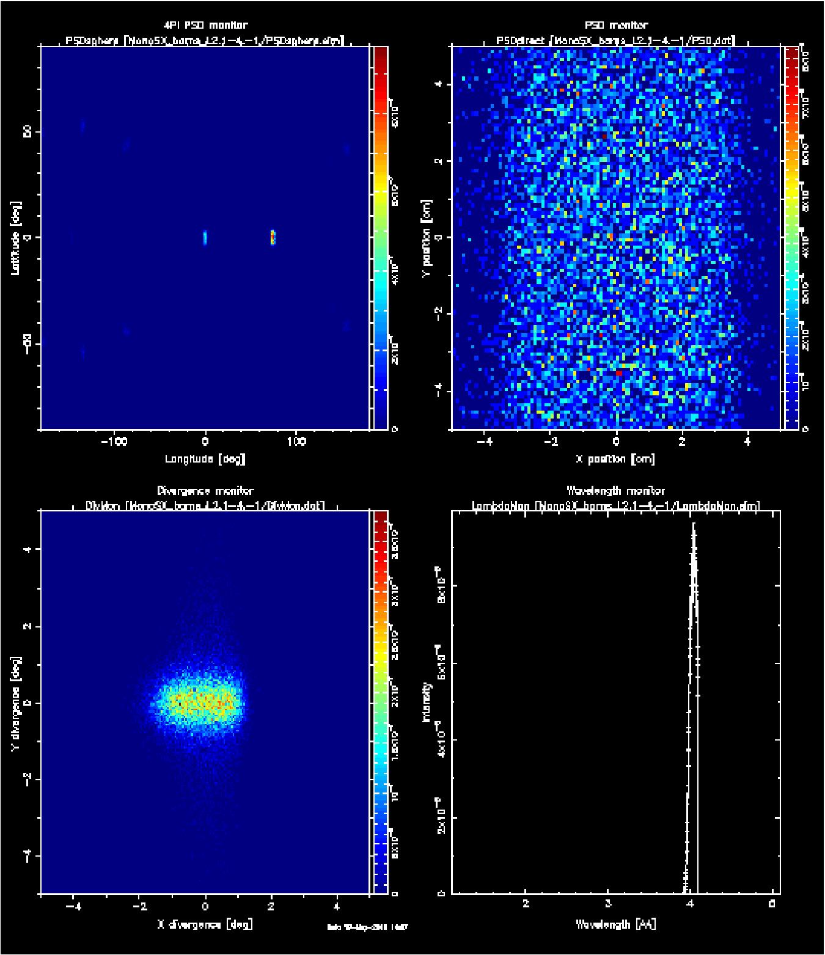
Single_crystal
λ=4.0-4.1Å
λ=2.1-4.1Å

